Slide 1
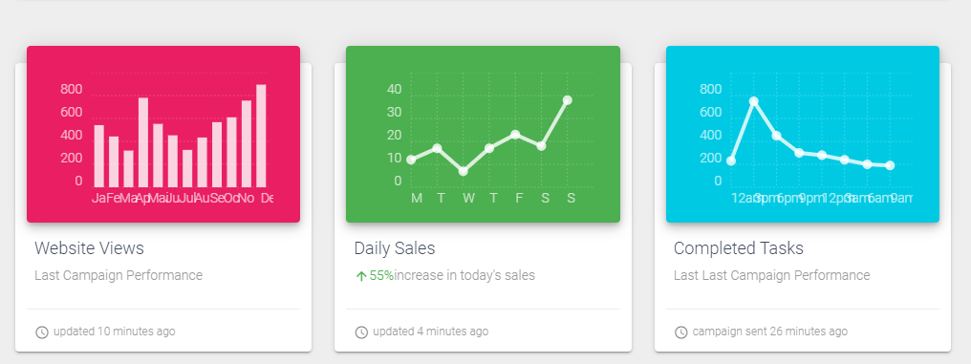
Using Vuetify and Voila to create web app from notebook
Vuetify
Vuetify is a Vue UI Library with beautifully handcrafted Material Components.
https://vuetifyjs.com/en/
Example

Slide 2
Using Vuetify and Voilà to create web app from notebook
Voilà
Voilà turns Jupyter notebooks into standalone web applications. Unlike the usual HTML-converted notebooks, each user connecting to the Voilà tornado application gets a dedicated Jupyter kernel which can execute the callbacks to changes in Jupyter interactive widgets.
Example
https://voila-gallery.org/
Implementation
Create Vuetify component using ipyvuetify
Build Covid-19 web app

